Slide 1
Manual TS_StressFiberSegApp
Takayuki Suzuki, Ziying Xu, and Daniel Yan
Sergey Plotnikov, Yun Chen

Slide 2
Read Me
The TS_StressFiberSegApp.mlapp is a MATLAB written to save you time in generating the segmented cells.
This slide deck contains instructions on:
How to add your preprocessing code to the app
How to use the App
How to load results
You are welcome to use your own app or MATLAB’s built in version of the code if you would like
Label images for computer vision applications - MATLAB (mathworks.com)

Slide 3
Add Preprocessing Code

Slide 4
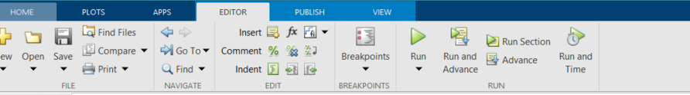
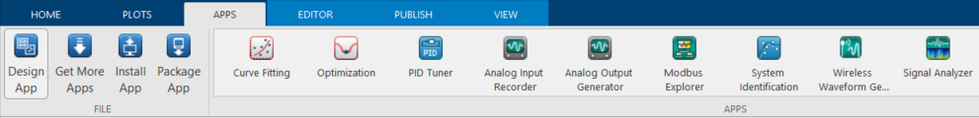
Start by Opening up the App Designer

Slide 5
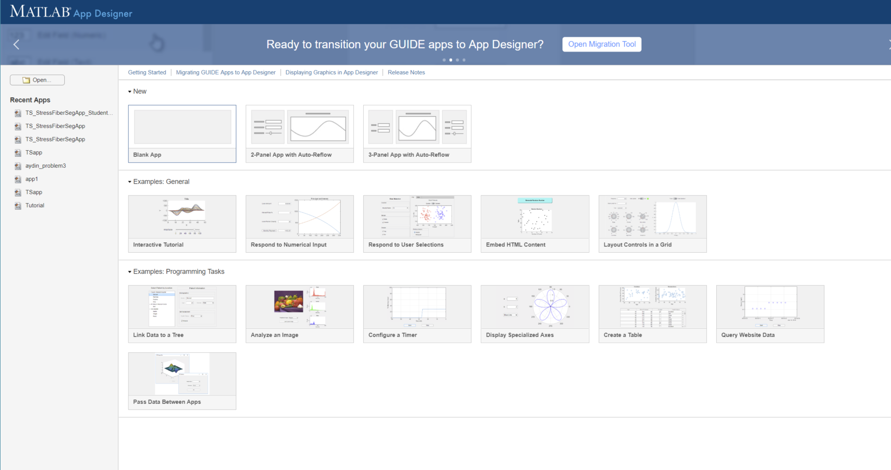
Open the TS_StressFiberSegApp.mlapp

Slide 6
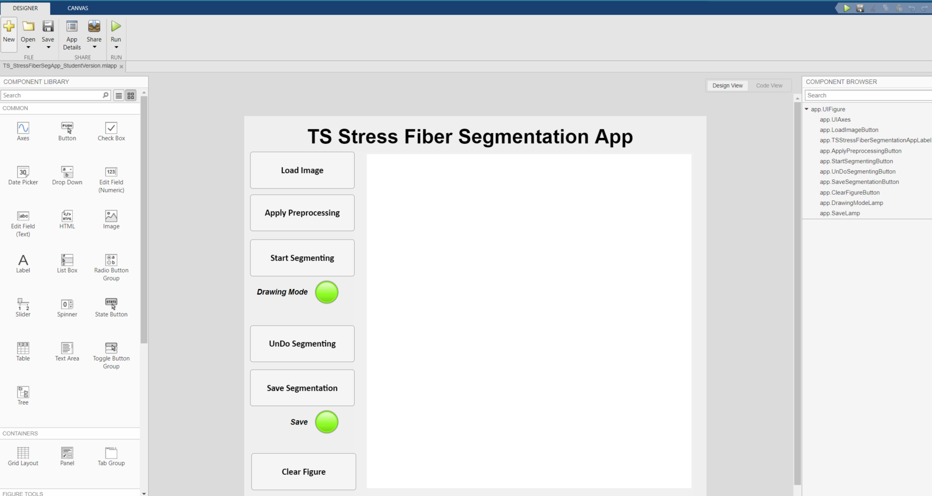
You Need to Update the App with your Preprocessing code

Slide 7
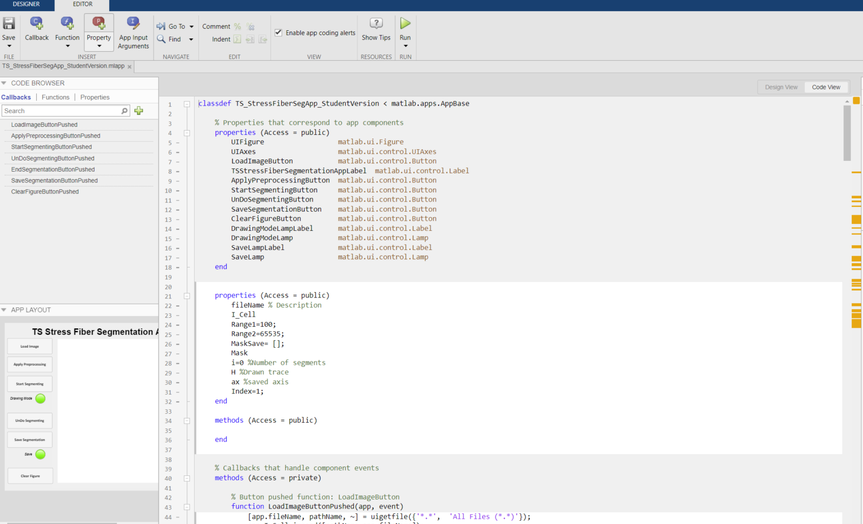
Scroll Down

Slide 8
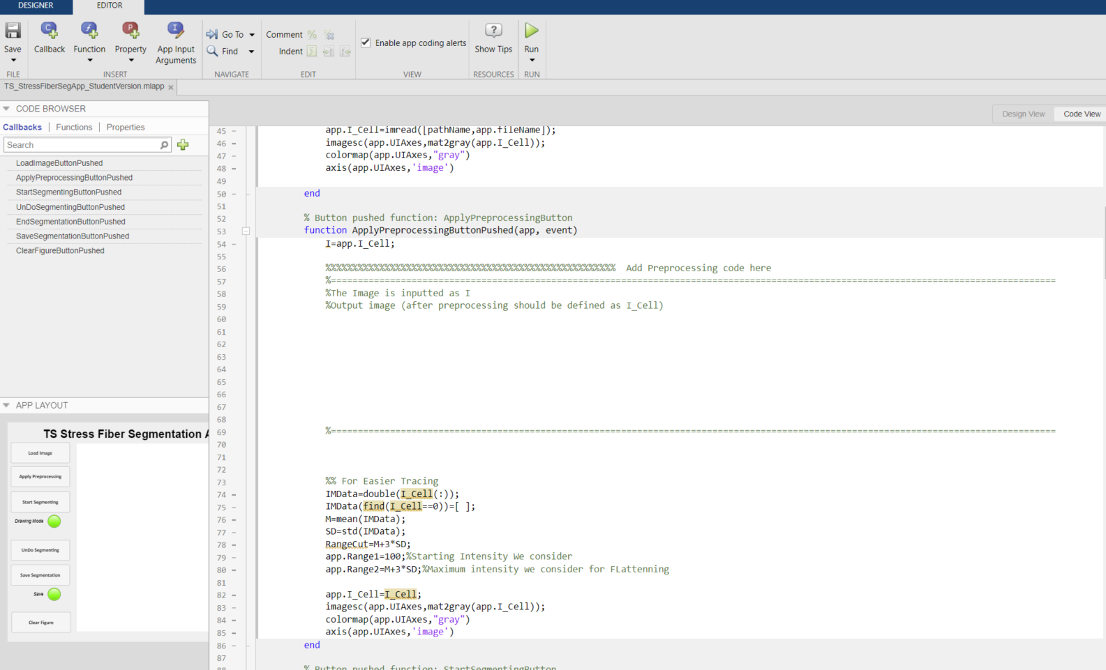
Paste in your Preprocessing code
Add preprocessing between the lines
Unprocessed Image is defined as “I”
Image with preprocessing is “I_Cell”

Slide 9
How to Use

Slide 10
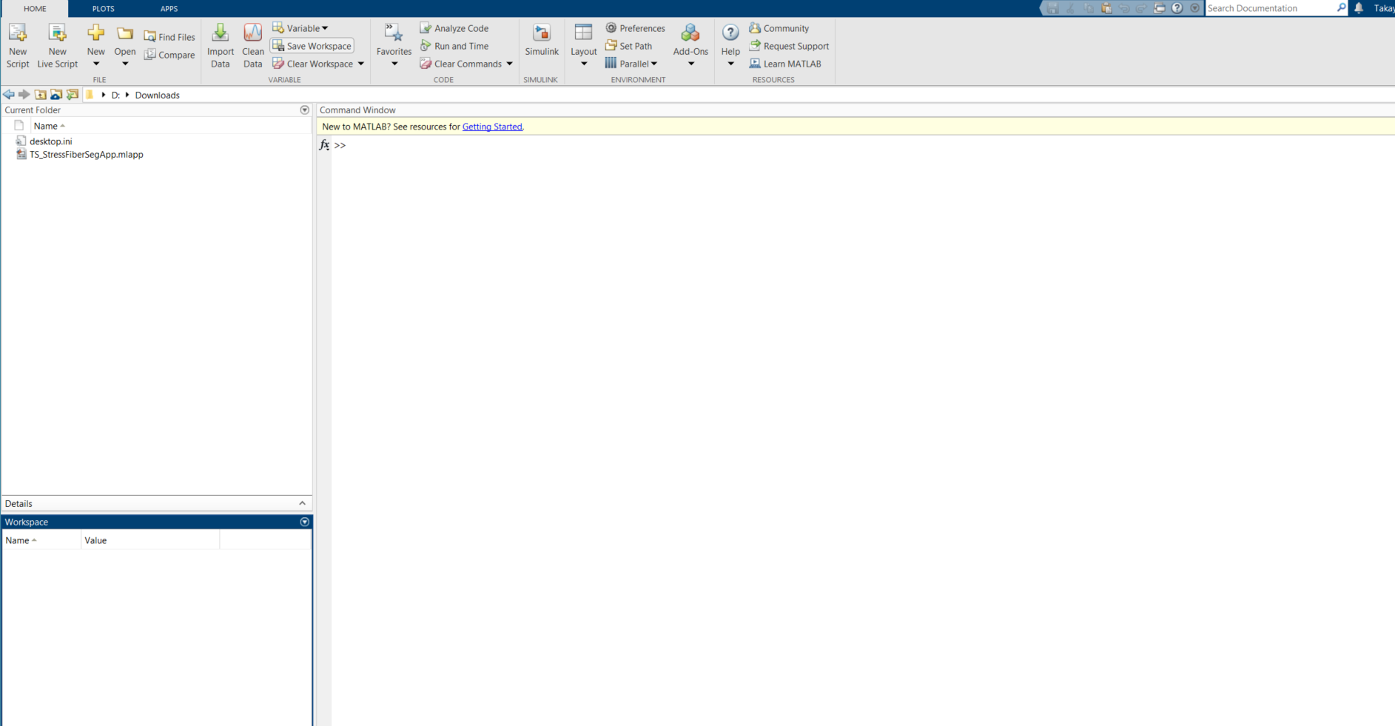
Make sure code and MATLAB is in correct directory (If it is not, then your segmented data will be shared in whatever folder you are currently looking at)

Slide 11
Double click app to open

Slide 12
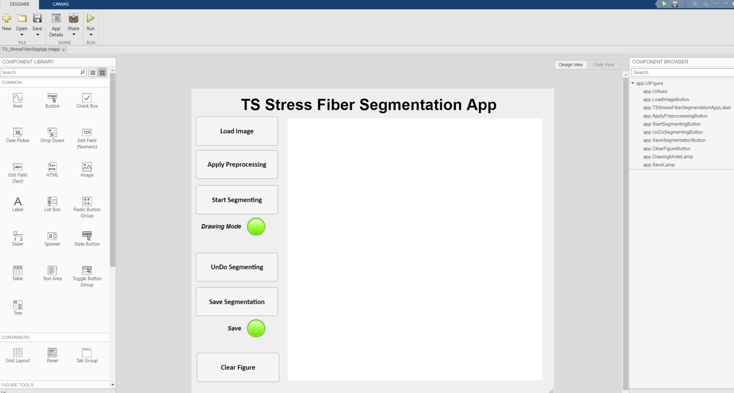
Run the App

Slide 13
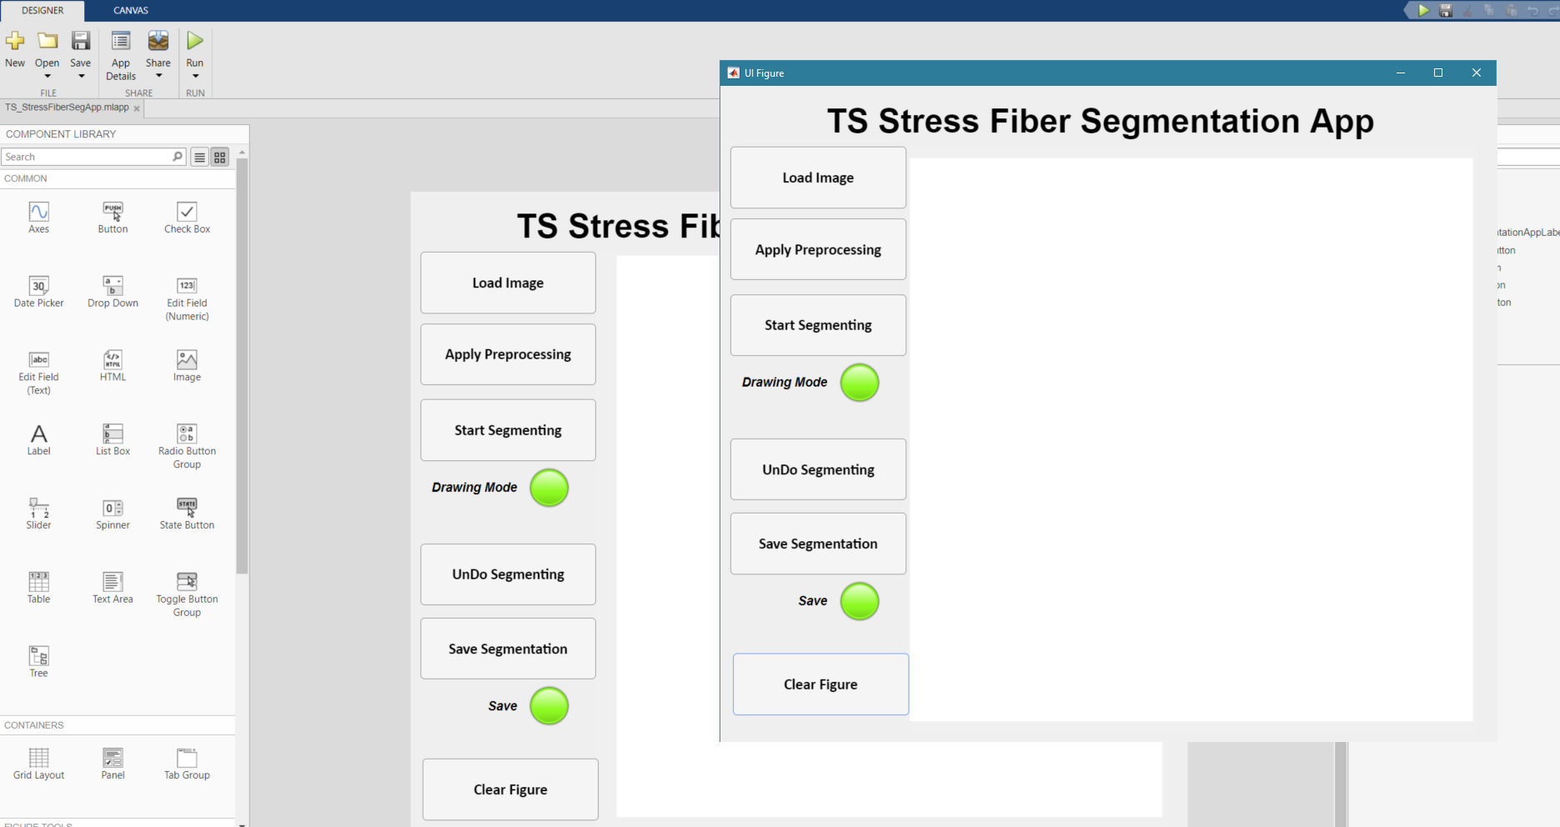
Figure will pop up

Slide 14
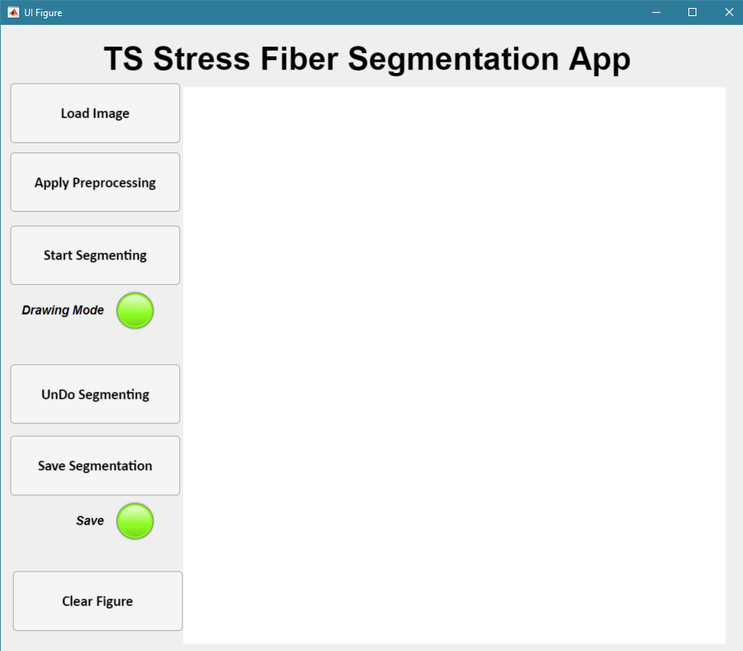
Start by Load image
A pop up will
Allow you to select
Actin image to analyze

Slide 15
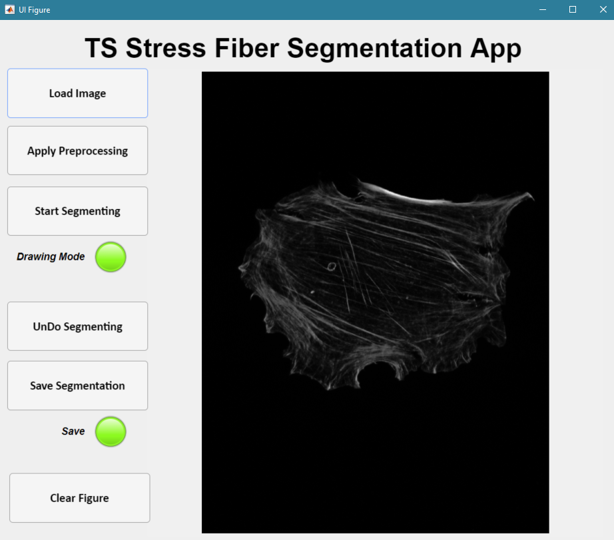
Apply Preprocessing (Note: You need to add this code)

Slide 16
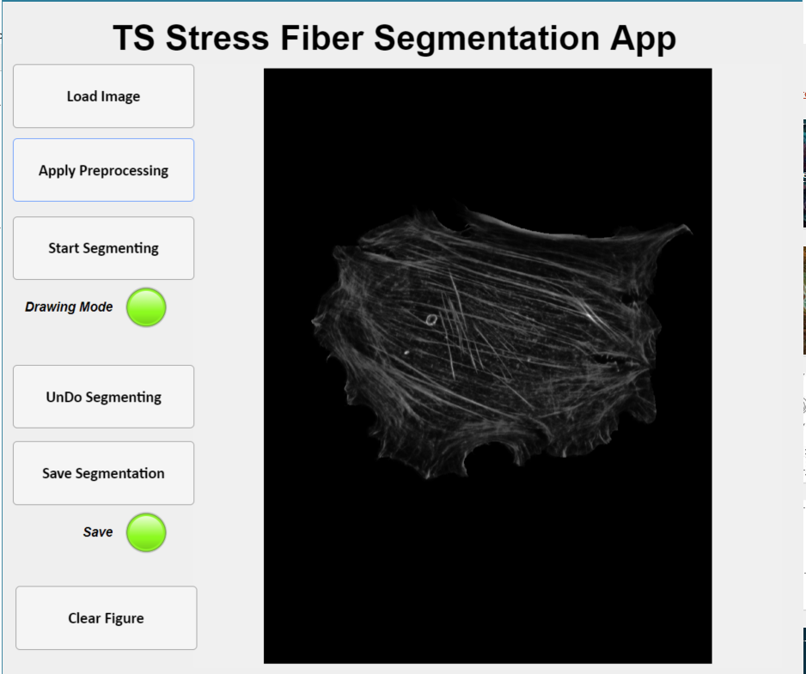
Start Segmentation

Slide 17
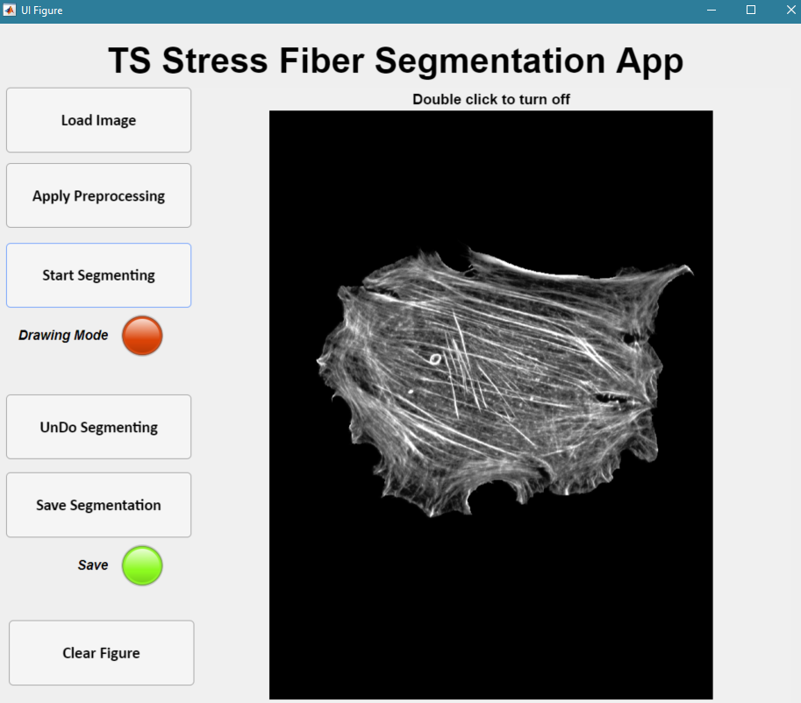
Sanity Check:
Image is Brighter
For easier Segmentation
Make sure Drawing Mode is “on”

Slide 18
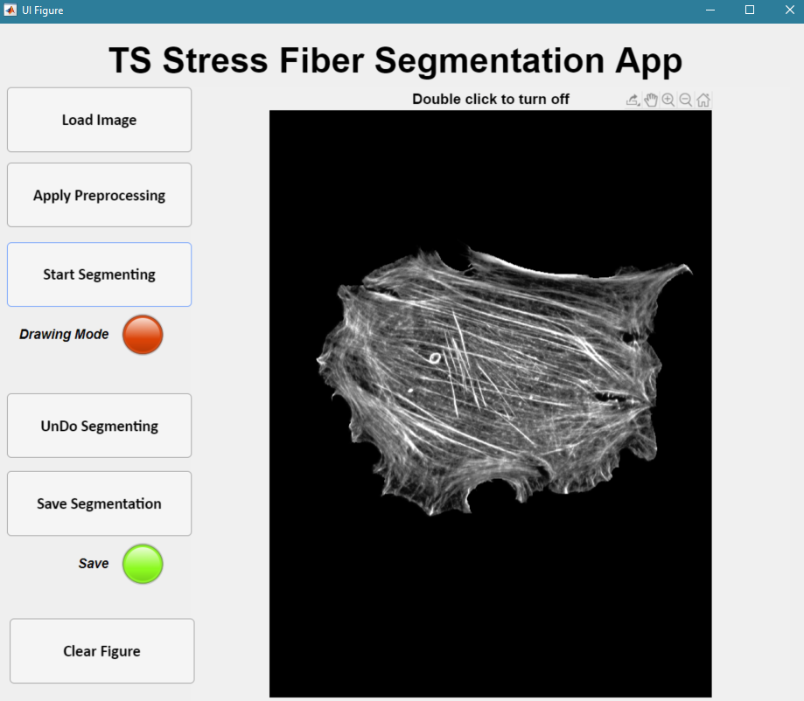
Zoom in:
Click “+” and scroll to zoom in to where you want to segment

Slide 19
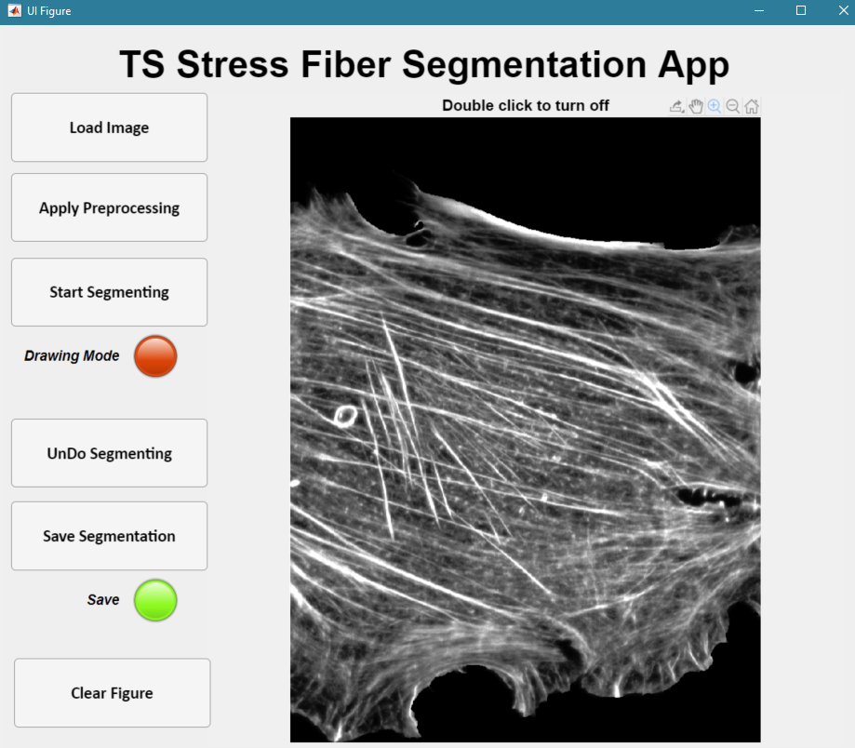
Important: Unclick the “+” after you zoom in
Unclick “+”

Slide 20
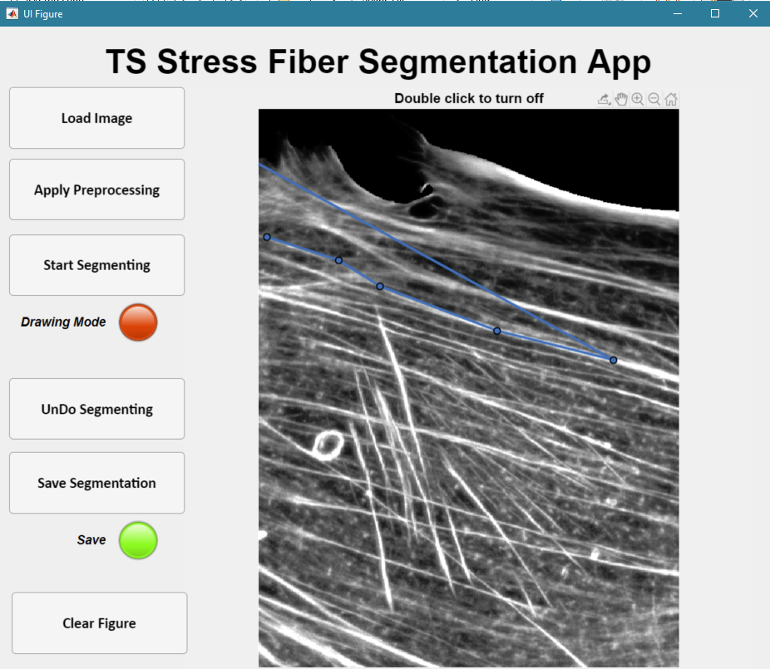
Start Segmenting
Single Click to place a node
Double click to end a fiber

Slide 21
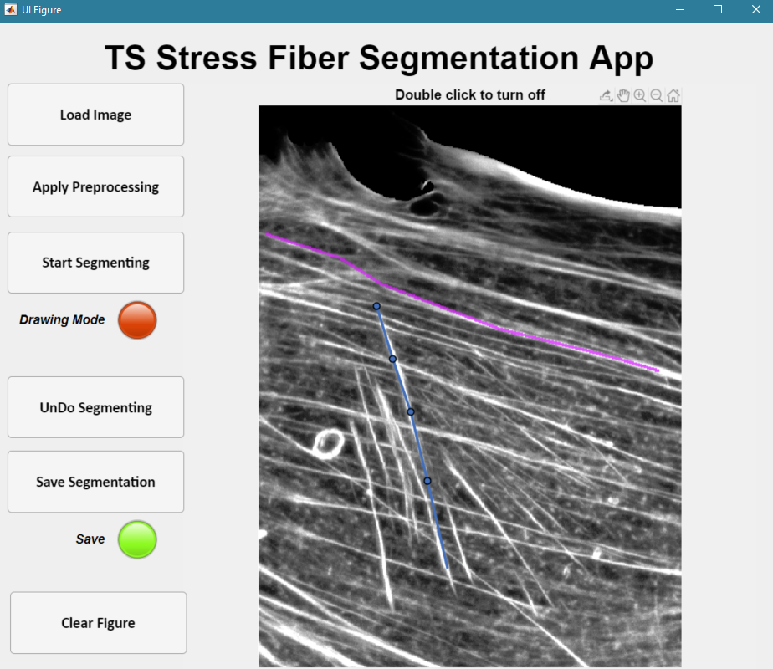
Do another fiber

Slide 22
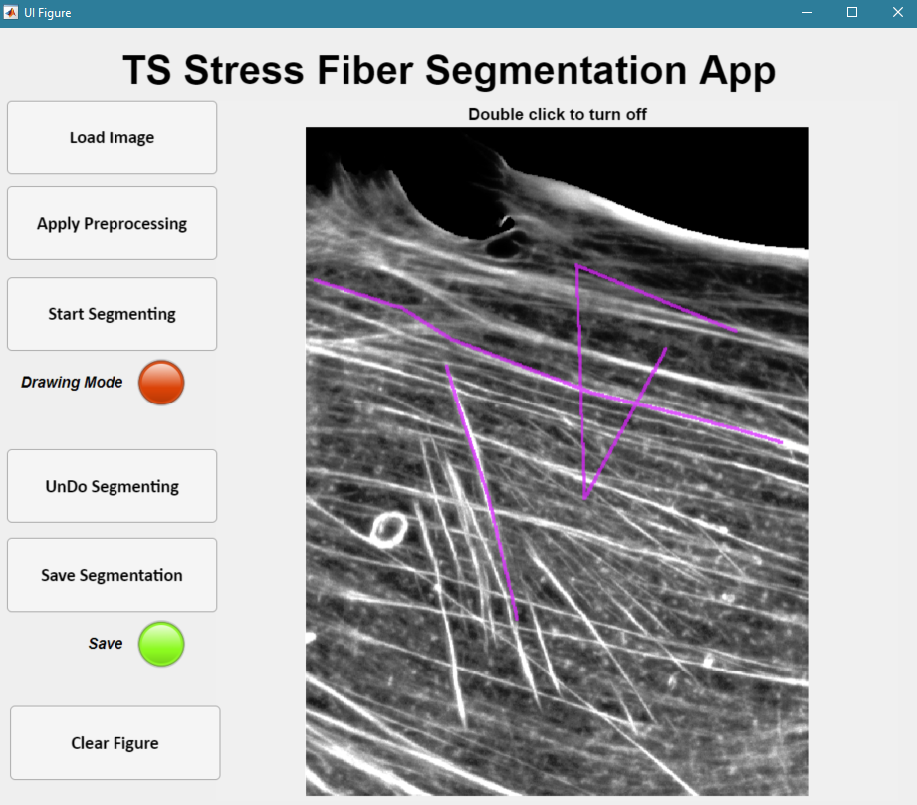
To Undo a segmentation: Exit Drawing Mode
Mistake in Segmentation
Double click anywhere to exit

Slide 23
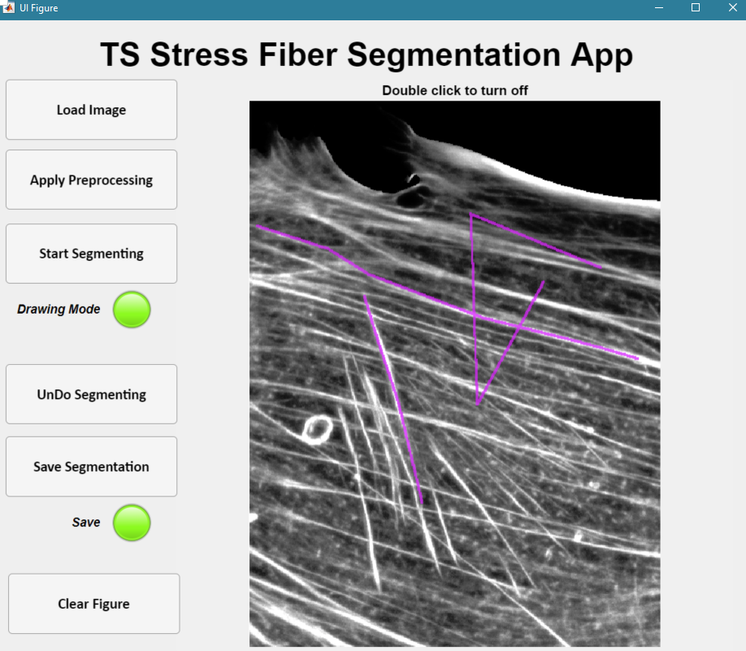
To Undo a segmentation: Un Do Segmentation
Make sure “off”
UnDo

Slide 24
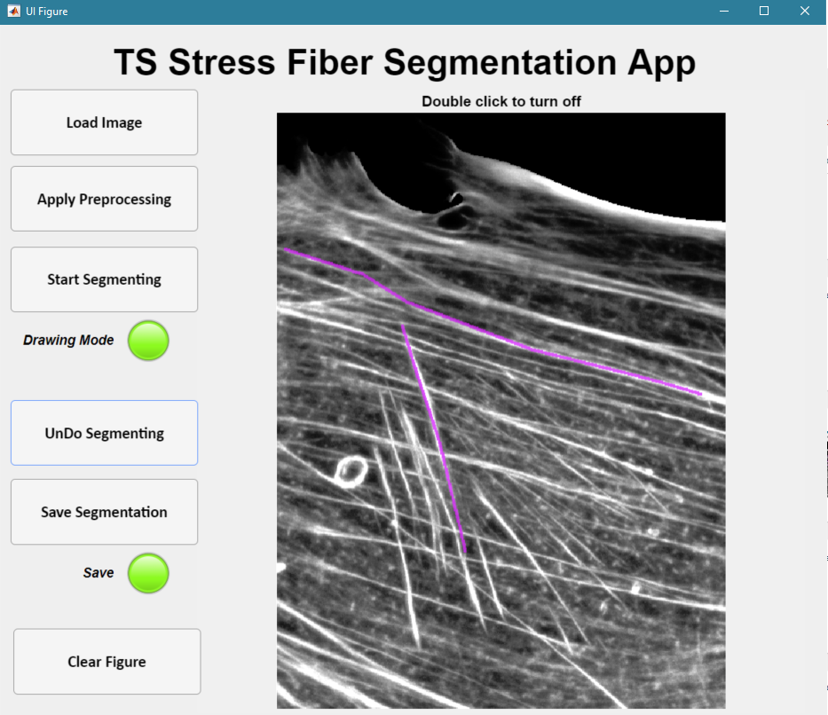
To Undo a segmentation: Un Do Segmentation
Start Again

Slide 25
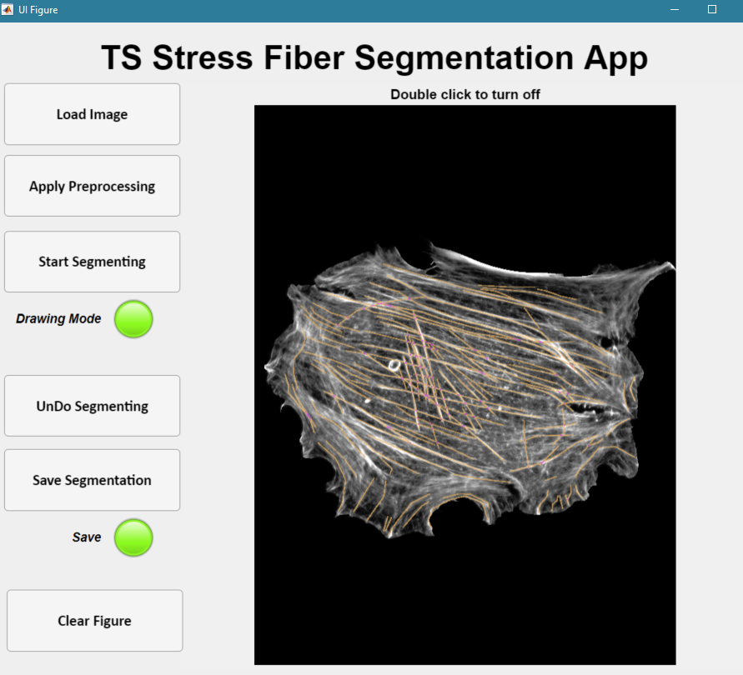
Exit Drawing Mode Once Finished
Make sure it is off
Double Click anywhere

Slide 26
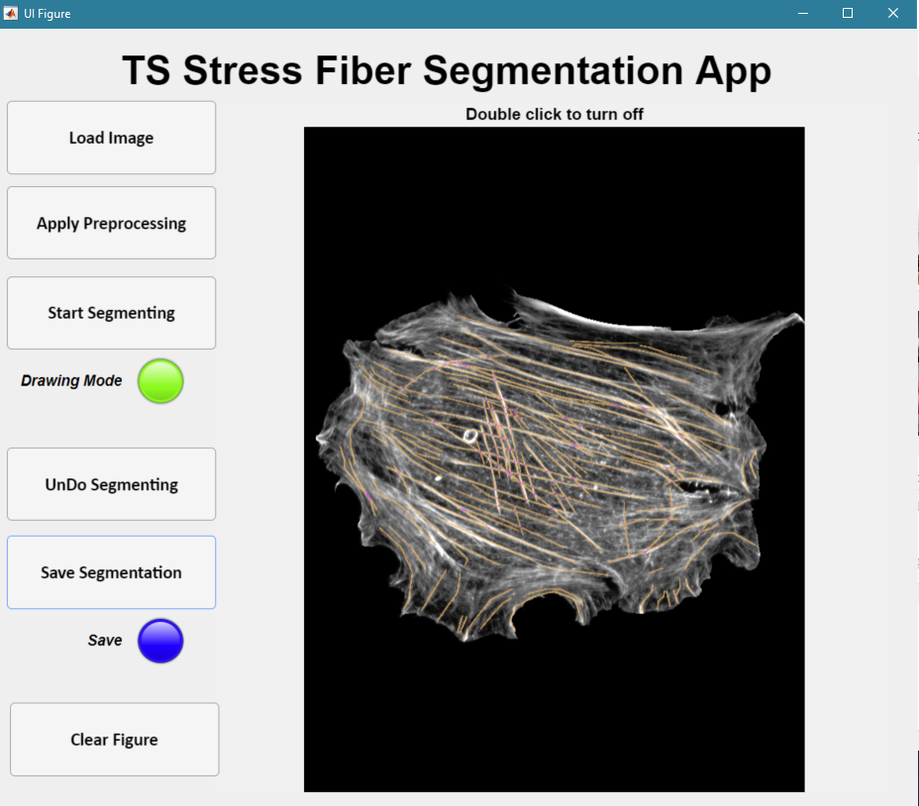
Save Segmented Results
Save Segmentation
(Light will be blue when done)

Slide 27
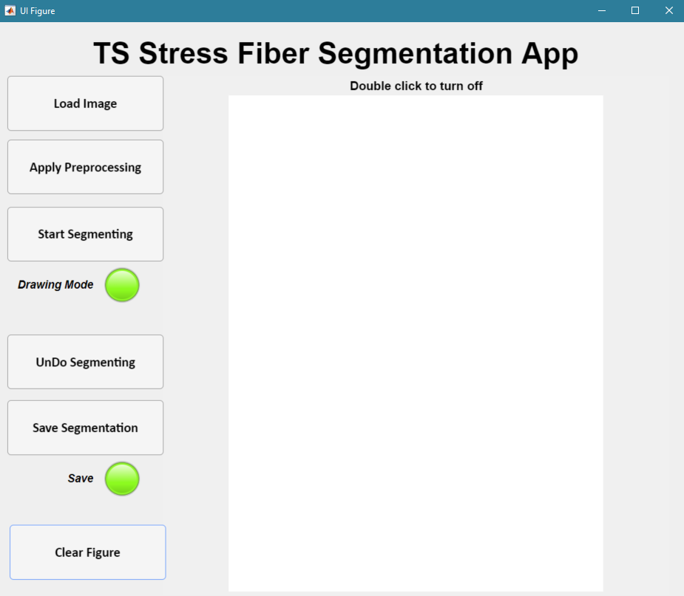
Clear Figure to Reset App

Slide 28
How Load Data

Slide 29
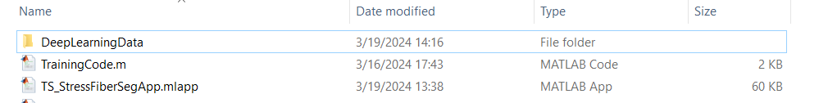
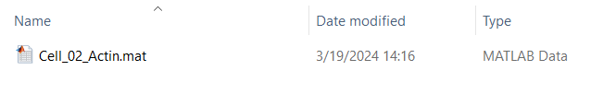
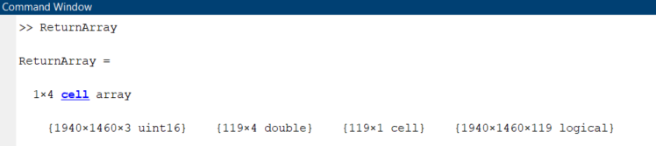
After Training: What we have

Slide 30
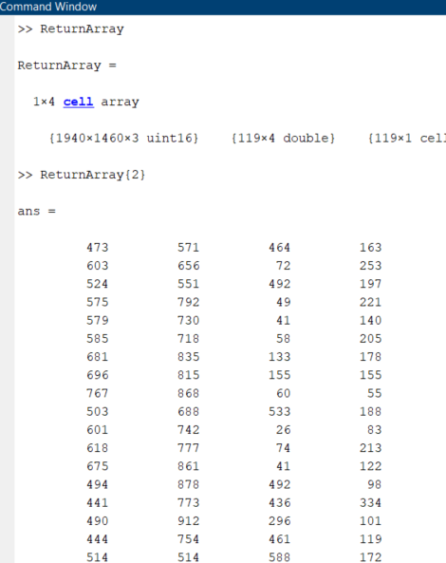
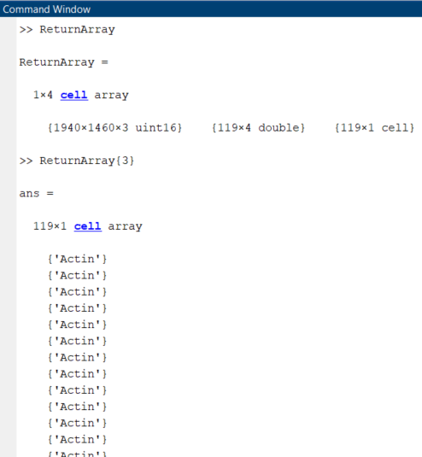
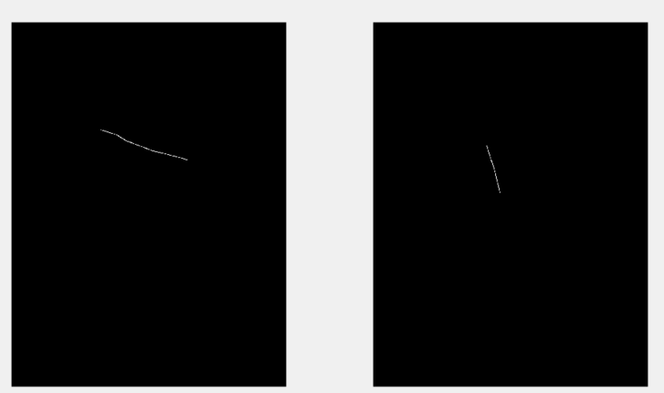
Contents of Return Array Getting Started with Mask R-CNN for Instance Segmentation - MATLAB & Simulink (mathworks.com)
Processed Image
Ground-truth bounding boxes
Instance Labels
Instance Masks

Slide 31
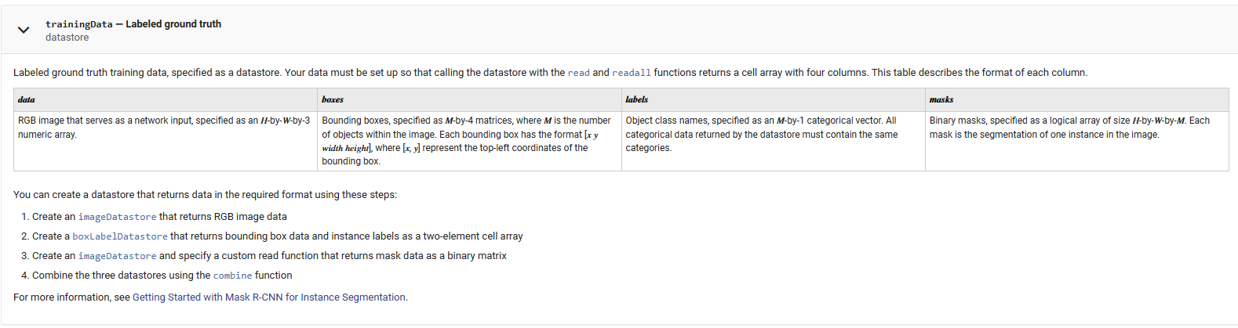
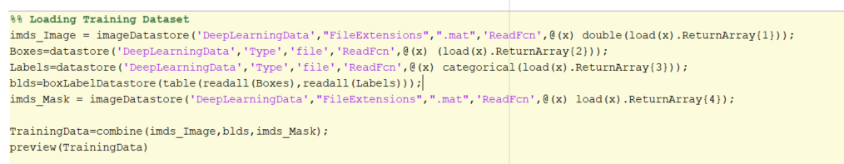
How to Load Data as a Data Store Train Mask R-CNN network to perform instance segmentation - MATLAB trainMaskRCNN (mathworks.com)
Rule of Thumb: read() should load below:
For us, run the following code: read(Training Data) gives us what we need!

